Slide 1

LNHS PTSA
Tuesday
January 17, 2023
6:30pm
General Meeting
Followed By Guest Speaker…
Ms. Whitfield, SAFE Coordinator

Slide 2

LNHS PTSA Meeting Agenda
January 17, 2023
Agenda:
Welcome/Confirm Quorum/FB Live Attendees
Meeting Called to Order by President
Introductions/Special Guests
Position Board Members
President Christal Feldman
1st VP - Membership Brenda Meadows
Treasurer Michelle Adamick
Recording Secretary Gabriella Nguyen
Corresponding Secretary Sophia Rogers
Chairs
LWL Advisors Suzanne Arnold/Tania Abreu
Finance Gita Raghoonandan
Staff Appreciation Angie Garcia/Hannah Howell
Legacy Bricks Dierdre Smith
Web Master Erika Remley
Staff Liaison Kari Grimm
OLD BUSINESS
Approval of Past Minutes (November)
Review of December Financial Report
NEW BUSINESS
Nominating Committee Election
Membership Updates
Spirit Wear Sales
Legacy Brick Campaign
Amazon Smile
Staff Appreciation
Learn with Lions
Communication Updates/Announcements
Next General Meeting - Wednesday, 2/15 at 6:30pm
Meeting Adjourned by President
January Meeting Topic: Meet Ms. Whitfield, SAFE Coordinator

Slide 3
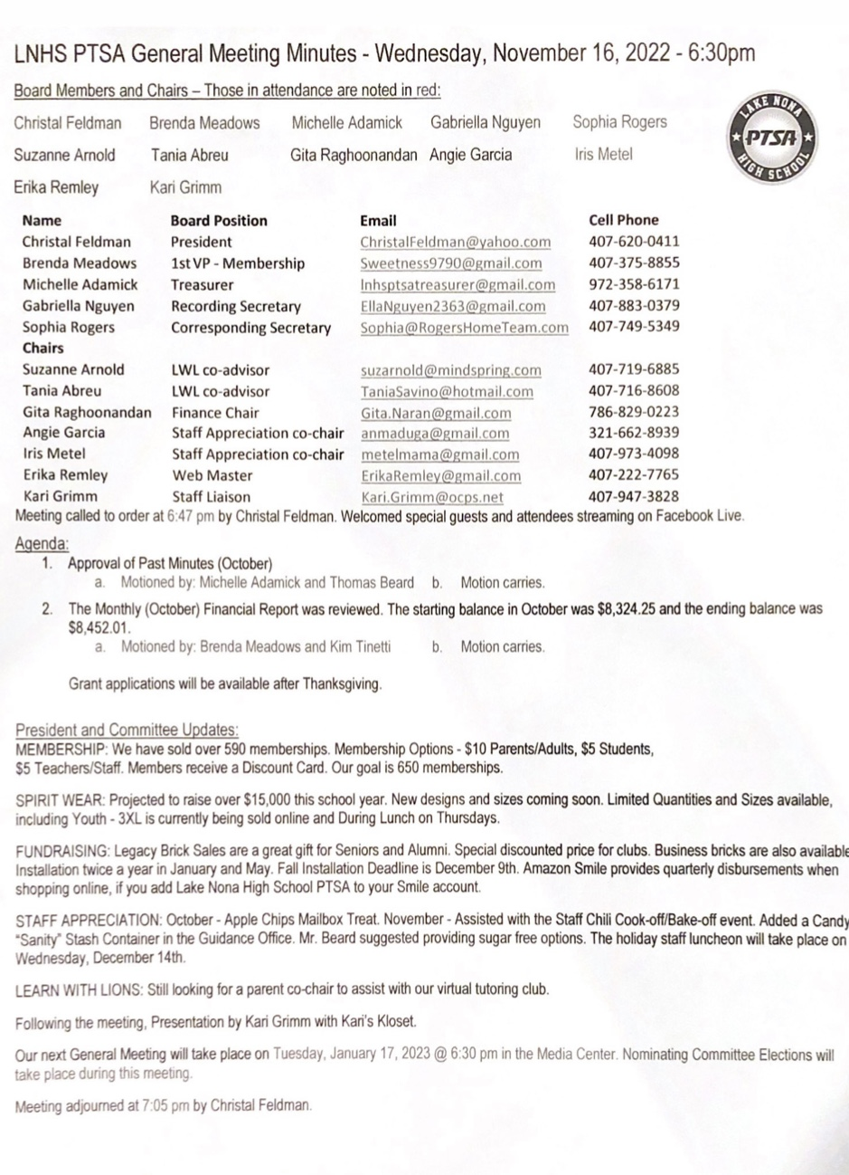

PAST
MINUTES
FOR APPROVAL
November 16, 2022

Slide 4
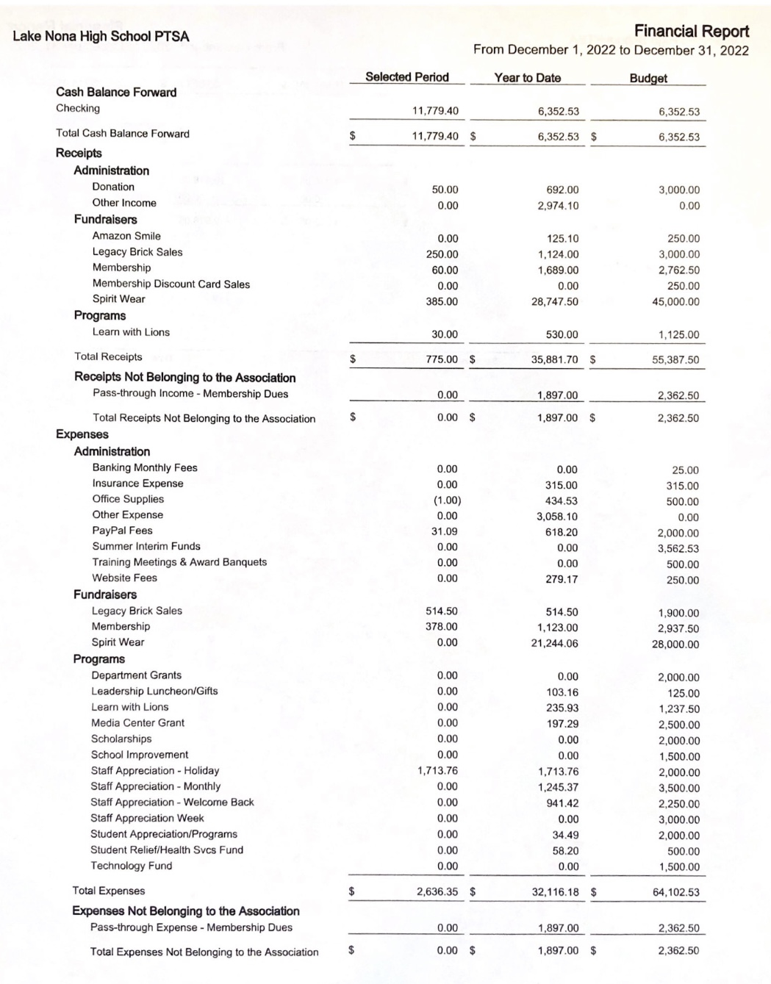
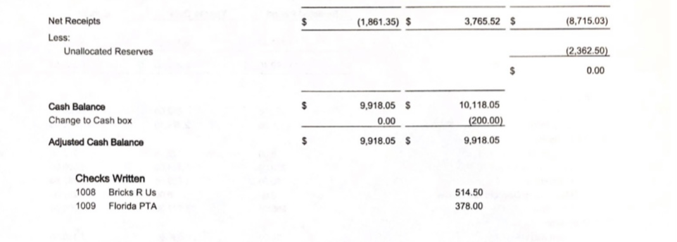
FINANCIAL REPORT
FOR APPROVAL
December 2022 Financial Report
Year to Date Summary
December Beginning Balance - $11,779.40
December Ending Balance - $9,918.05

Slide 5
NOMINATING COMMITTEE
ELECTIONS
LNHS PTSA Bylaws ARTICLE VI - Section 3: Nominating Committee
a. There must be a nominating committee elected, composed of 3 or 5 members, the number determined by the association at a regular meeting at least one month prior to the election of officers. The president shall appoint a chair pro tem who shall call the first meeting. The committee shall elect its own chair.
b. The nominating committee shall nominate one person for each office to be filled and report its nominees at the election meeting at which time additional nominations may be made from the floor.
In order to be nominated a person must be a member of this PTSA.
c. Only those persons who have consented to serve if elected shall be nominated for or elected to such office.
d. Members of the nominating committee may be elected to office.

Slide 6
NOMINATING COMMITTEE
ELECTIONS
Ballot Voting Instructions
Any LNHS PTSA Members are allowed to vote.
These Members should have received a Voting Delegate card.
(If not, please let us know and we will confirm your membership and give you a card.)
On Your Ballot:
Write the Names of ALL Nominees in the order listed.
Put an "X" in front of the 5 Names that you want to vote for.
You should fold the ballot in half, twice.
Then raise your ballot and wait for the Tellers to collect the ballots.
Do NOT turn in your Voting Delegate slip in case we need to reballot.
Voting should take no longer than 10 minutes.
The Top 5 Nominees will be elected to serve on the Nominating Committee.

Slide 7


PTSA
MEMBERSHIP
- Currently Over 615 Memberships Received
- Our Goal is 650 Memberships
Membership Options
Parent/Adult - $10
Teachers & Staff - $5
Students - $5
(Includes Discount Card)

Slide 8

SPIRIT WEAR
- Limited Quantities and Sizes Available
(Youth up to 3XL)
- Spirit Store On Campus
(Thursdays During Lunch)

Slide 9

LEGACY
BRICK SALES
- Great Gift for Seniors & Alumni
- Special Pricing for Clubs
- Business Bricks Available

Slide 10

Add Lake Nona High School
to Your Amazon Account
while shopping ONLINE!
www.smile.amazon.com

Slide 11

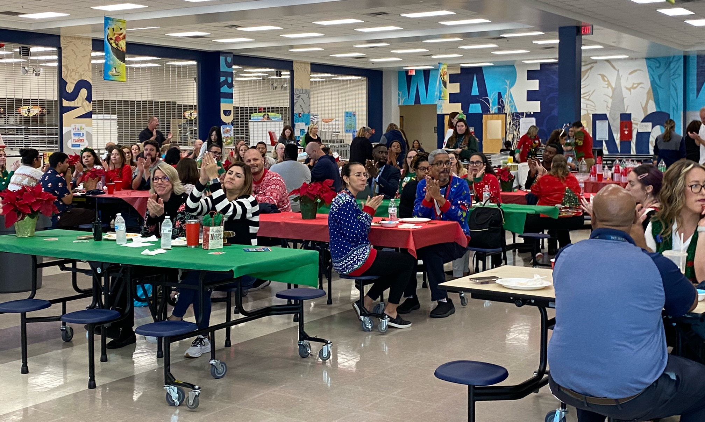

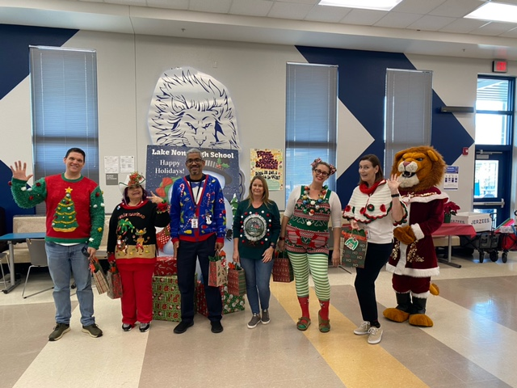
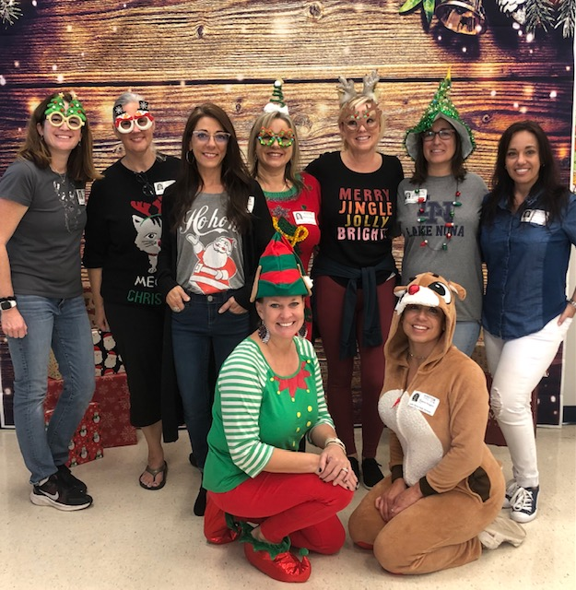
STAFF
APPRECIATION
December
Holiday Staff Lunch
Upcoming Event
Staff Breakfast
January 24th

Slide 12

LEARN WITH
LIONS
Virtual Tutoring Club
Application Date Extended

Slide 13

PTSA STAFF APPRECIATION

Slide 14



STAY CONNECTED
WITH LNHS PTSA
www.LNHSPTSA.com
www.Facebook.com/LNHSPTSA
SAVE THE DATE
Next General Meeting
February 15th at 6:30pm
(Wednesday)
Dual Enrollment

Slide 15
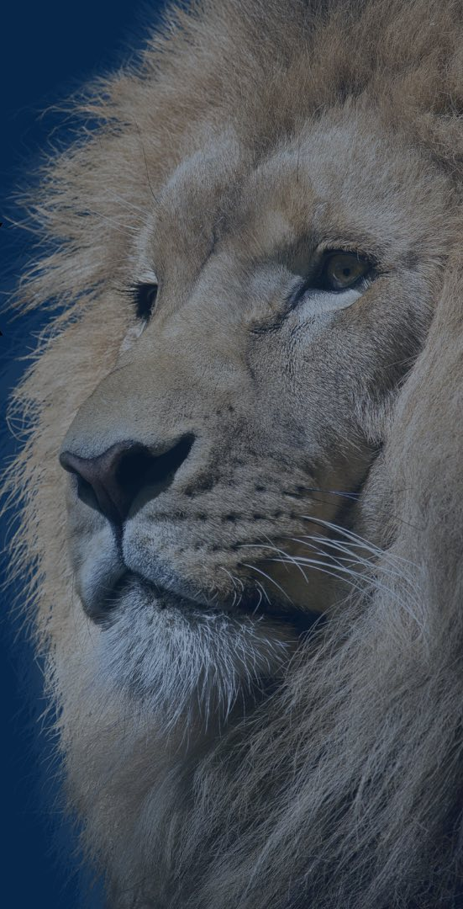

LNHS PTSA
January Meeting Topic
Meet Our
SAFE Coordinator
Ms. Whitfield
Tammy.Whitfield@ocps.net
www.lakenonahs.ocps.net/student_services/s_a_f_e

